Slide 1

Internship Oral Presentation
By: Tay Kong Chun, Victor
Temasek Laboratories

Slide 2
Contents
Objectives for this Internship
What had been achieved?
What is Visual Odometry?
What is SLAM?
Pros and Cons
VIO: S-MSCKF
SLAM: ORB_SLAM2
Improved Implementation Design
Future Works
What have I learnt from this Internship?

Slide 3
Objectives for this Internship
To assist the Control and Guidance Group in developing and improving on an existing visual odometry system for Unmanned Aerial Vehicle.
Fully understand the workings of the current visual odometry system used
Design and improve on the current visual odometry system used
Adding loop-closure algorithm to enhance the system to be more robust and accurate
Proper documentation of the design
Implement the improved designed visual odometry system

Slide 4
What had been achieved?
Fully broken down the current visual odometry system used
Designed the addition of loop-closure algorithm from another well tested system to enhance the current system
Prepared proper documentation of the design
Implemented most of the improved designed visual odometry system

Slide 5
What is Visual Odometry (VO)?
Estimating the motion of a camera in real time using sequential images
Usually done with either Mono or Stereo camera setup
Used when GPS is unable to provide a position estimation of camera in real time
Can be further enhanced with the use if Inertia-Measurement Unit (IMU) for added robustness and accuracy
System is called Visual Inertia Odometry (VIO)

Slide 6
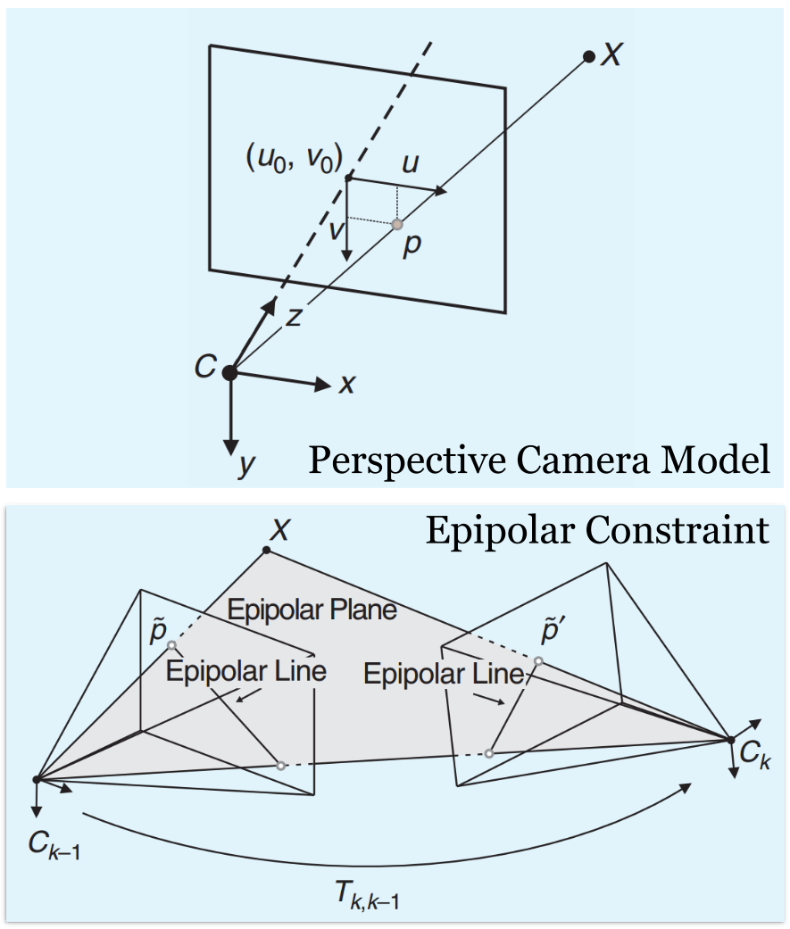
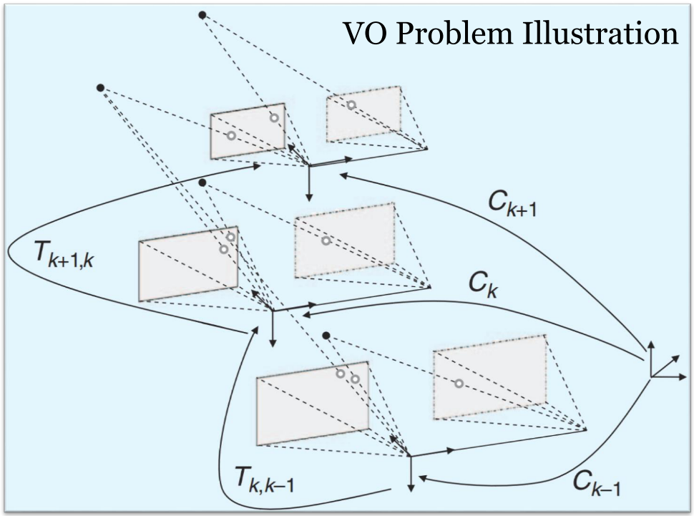
What is Visual Odometry (VO)?

Slide 7
What is SLAM?
Simultaneous Localization and Mapping (SLAM)
Estimating the motion of a camera in real time using a map
Map of an unknown environment is drawn using feature points detected in the images captured by the camera
All are done concurrently
Usually done with either Mono or Stereo camera setup
Used when GPS is unable to provide a position estimation of camera in real time
Can be further enhanced with the use if Inertia-Measurement Unit (IMU) for added robustness and accuracy

Slide 8
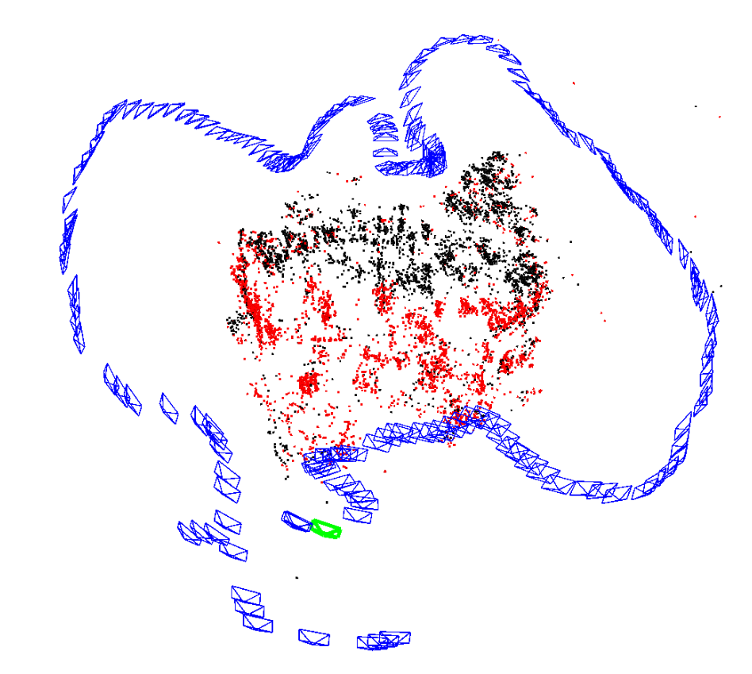
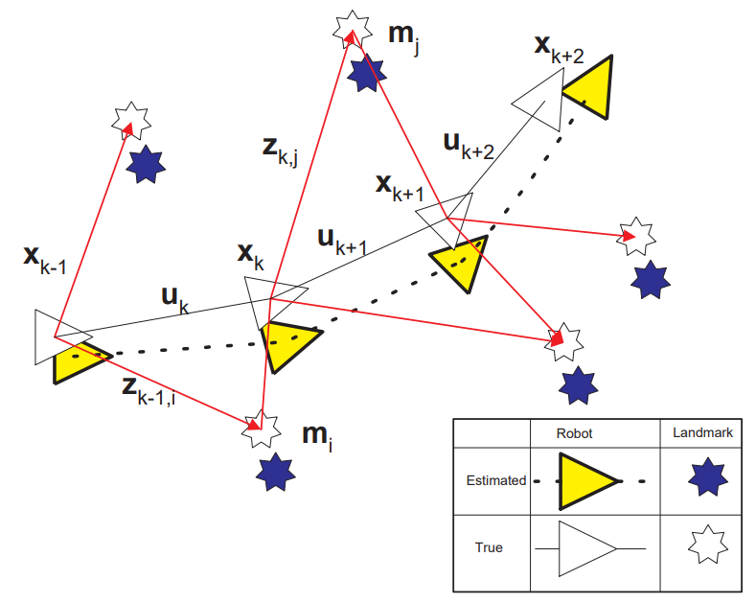
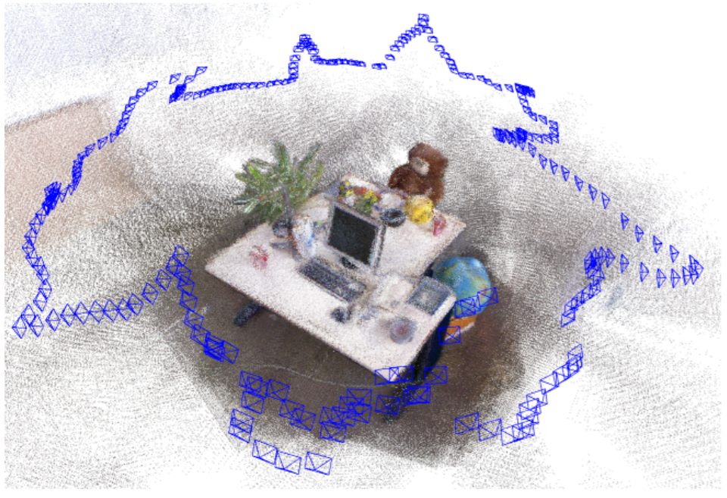
What is SLAM?
Position Estimation Drift Error

Slide 9
Pros and Cons
Visual Inertia Odometry (VIO)
Simultaneous Localization and Mapping (SLAM)
Pros
Faster algorithm frequency
Lesser computational requirement
Cons
Less accurate robust
Very susceptible to drift over time
Pros
More accurate and robust
Able to detect past frames and correct drift
Cons
Slower algorithm frequency
Higher computational requirement

Slide 10
VIO: S-MSCKF
Current system used by Control and Guidance Group
Stereo RGB Camera setup
Semi-direct method
Fast algorithm frequency
Requires only a small sensor package
Stereo Camera and IMU
More accurate and more efficient than state-of-art monocular solutions
Compared to VINS-Mono and OKVIS

Slide 11
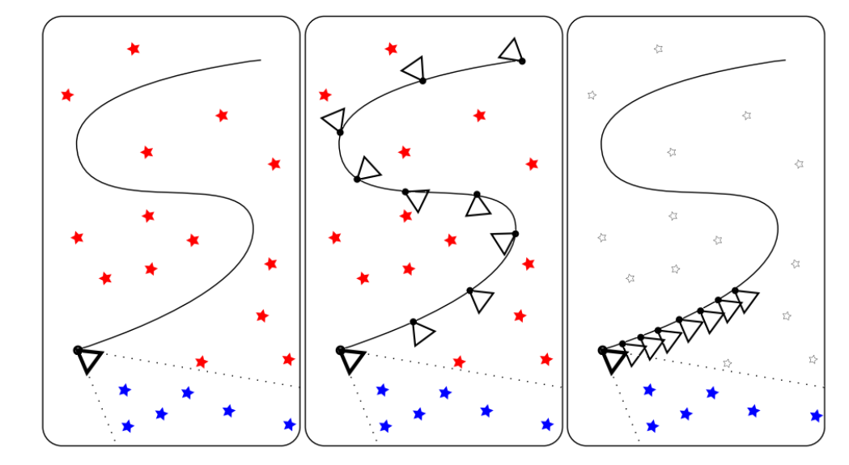
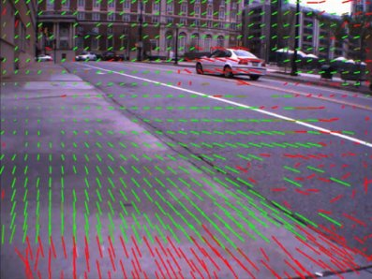
VIO: S-MSCKF
Semi-direct method using optical flow
Difference between EKF SLAM, keyframe-based SLAM and MSCKF

Slide 12
SLAM: ORB_SLAM2
State-of-art SLAM algorithm
Capable of using multiple types of camera setup
Mono, Stereo, RGB-D
Feature-based method
Relatively slow algorithm frequency
Requires only a small sensor package
Mono, Stereo or RGB-D camera
Robust and accurate loop-closure algorithm to correct drift-error in position estimation over time

Slide 13
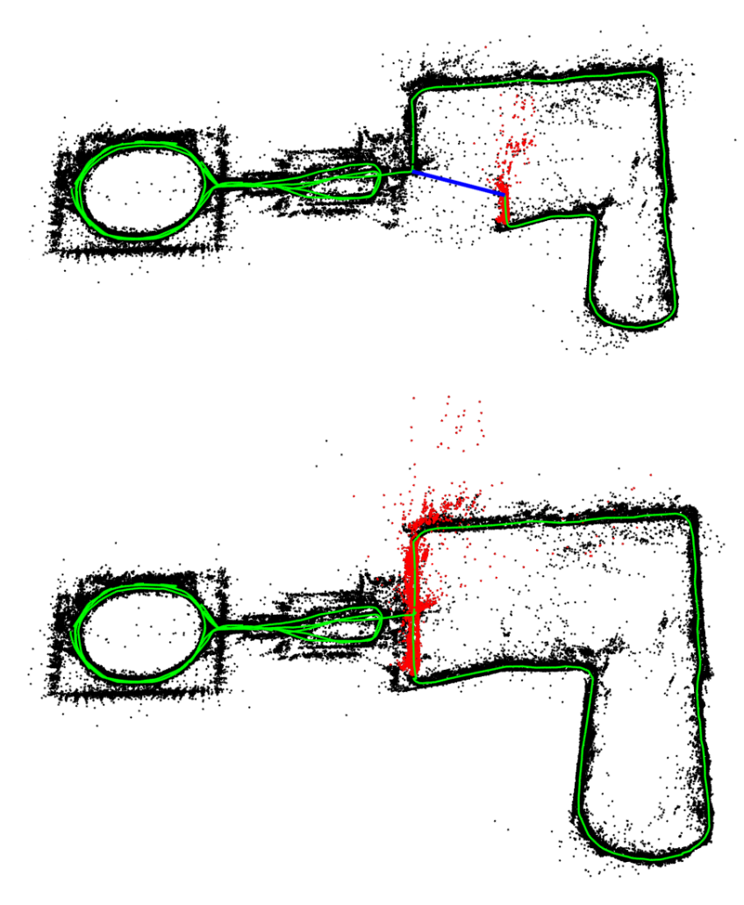
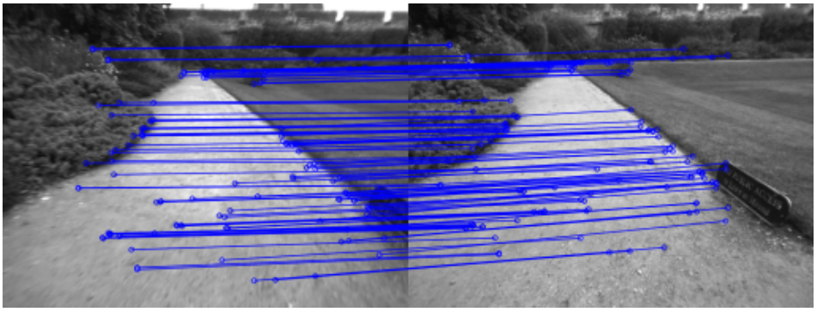
SLAM: ORB_SLAM2
Example of loop detected
Loop detection and fusion with backward correction

Slide 14
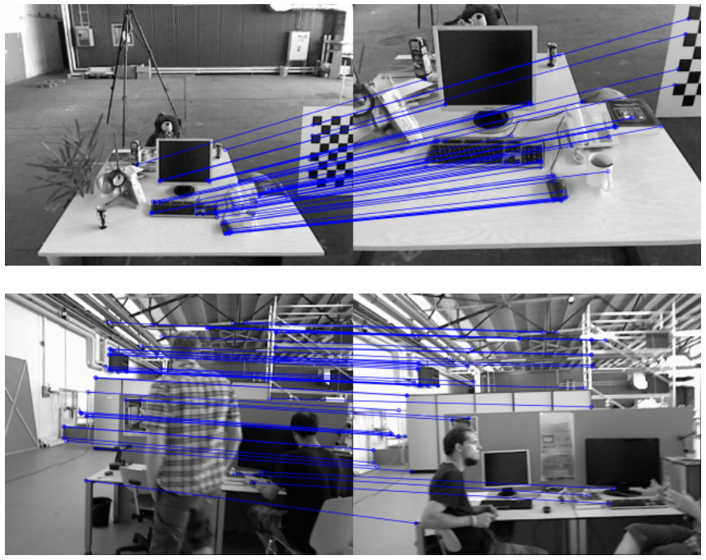
SLAM: ORB_SLAM2
Collections of keyframes with feature points in a map
Loop detection with severe scale change and dynamic objects in the image

Slide 15
Improved Implementation Design
Big difficulty in porting the loop-closure algorithm only from ORB_SLAM2 to S-MSCKF
ORB_SLAM2 is Feature-based while S-MSCKF is Semi-direct Optical Flow
Proposed design:
Use S-MSCKF as the main Tracking algorithm to replace the Tracking algorithm thread in ORB_SLAM2
Pass the finalized corrected pose to S-MSCKF for pose correction after loop fusion in ORB_SLAM2
Reset Sliding Window in S-MSCKF after pose correction

Slide 16
New Implementation Design
Create New Keyframe
S-MSCKF
New Camera Image
ORB_SLAM2
Pose Estimation of Current Frame
Loop_Closure
Detect Loop
Replace Pose with Corrected Pose
Send Corrected Pose
Corrected Pose of Current Frame
Send Corrected Pose
Reset Sliding Window

Slide 17
New Implementation Design
Implementation:
Everything is coded with the new implementation design
Current Issues:
Multi-thread randomly kill the node
Very computationally heavy
Overall algorithm frequency is low
Code is not optimised

Slide 18
Future Works
Fix the issue of multi-thread randomly kill the node
Find ways to optimise the code

Slide 19
What have I learnt from this Internship?
Self learning is very important
Must keep a detailed documentation of everything that is done
Must be able to communicate ideas and information clearly with others
Thinking out of the box for solution is key to solving problems

Slide 20
Thank You!
Any Questions?

